Slide 1

Liping’s Journey

Slide 2
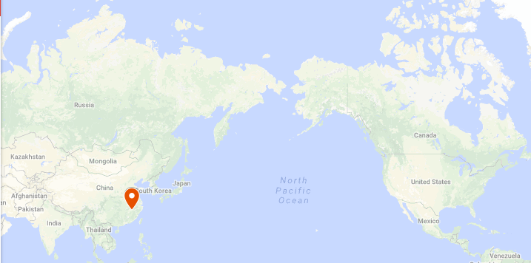
1983

Slide 3

1983

Slide 4
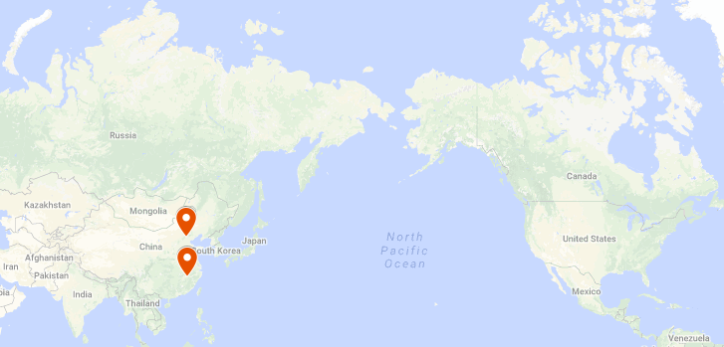
2001

Slide 5
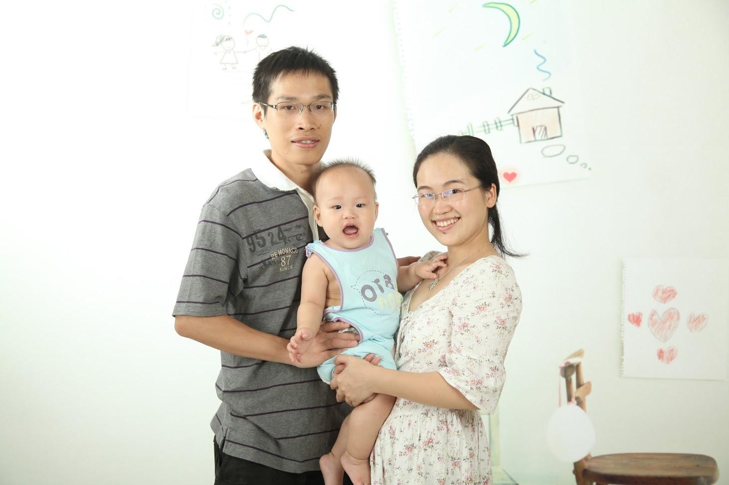
2010

Slide 6
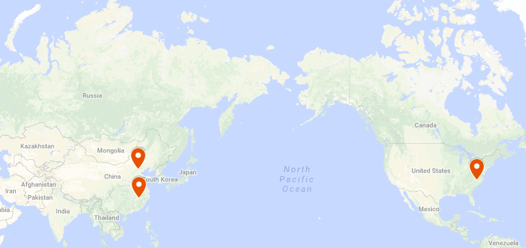
2012

Slide 7
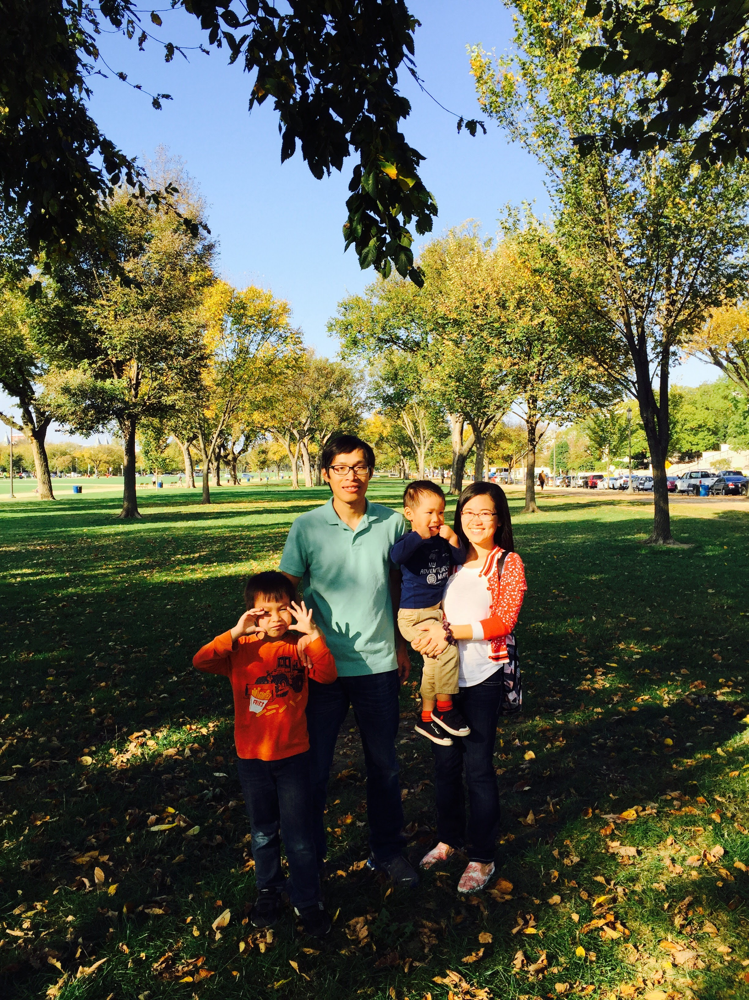
2012

Slide 8
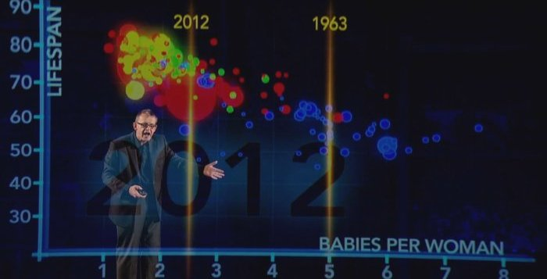
2015

Slide 9
MFA Boston and Houston
Data Scientist with Python
Lean In Book Club
17 Courses
4 SAS
Certificates
Google Analytics IQ
SAS, Python, SQL, Tableau

Slide 10
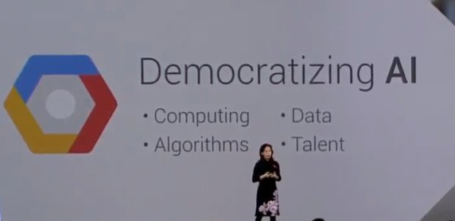
Democratizing AI
Notes:
democratic of deep learning feifei li
- MOOC
- Tools
--anaconda, tensorflow

Slide 11
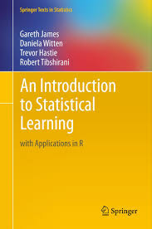
Interest on Machine Learning
DM/ML Courses at IAA
DataCamp
Introduction to Statistical Learning from Stanford Online

